Slide 1
Feeding Strategies

Slide 2
Feeding Strategies
Carrion: eating dead fleshr
Generalist: eating a variety of prey, depending on what’s available
Specialist: an animal
That eats one or
very few types of food.

Slide 3
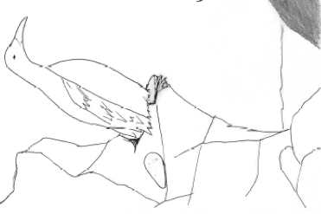
How do birds catch food?
Surface Feeders
Dip mouths in while
Swimming/sitting on water.
Pursuit Diving
Swim underwater in pursuit
of prey - use feet or wings.
Enlarges area to hunt food.
Plunge Diving
These species ‘dive bomb’
into the water directly from
flight – very specialized!
Kleptoparasitism
Aquilina Lestenkof
Scavenging, and predation. Stealing

Slide 4
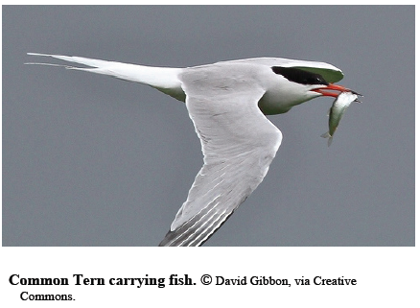
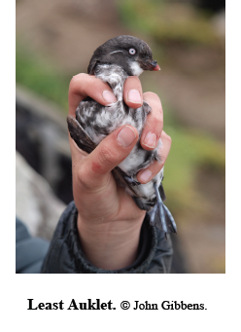
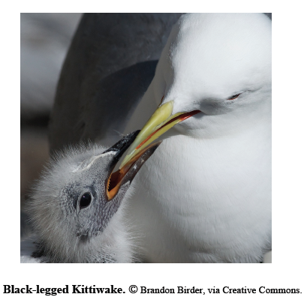
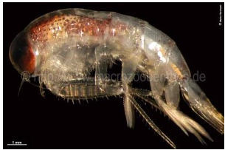
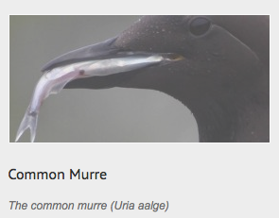
How do birds feed their chicks?
Feed whole prey.
Regurgitation.
Throat or gular pouch.
Stomach Oil.

